Slide 1
Data!
Organizing, Visualizing, & Sampling

Slide 2
Types of Data: Qualitative
Often called categorical data
Non-Numerical / Labels / Categories
Nominal if labels have no order / ranking
Examples: Name, major, gender, nation, season
Ordinal if labels have order / ranking
Examples : Grades (A, B, C…), Place (1st, 2nd, 3rd…), Education level (High School, Undergrad, Graduate), Scales 1-10*
Can have numeric labels, but they are still labels, not quantitative data upon which math can be done - 2nd place isn’t 5x better than 10th - INTERVALS MAY NOT BE EQUAL
NOT LESS IMPORTANT / USEFUL THANK QUANTITATIVE DATA - We still do quantitative work with this data, it’s just of a different nature

Slide 3
Organizing One Categorical Variable
Summary Table: A table tallying frequencies or percentages
Used for a single categorical variable
Favorite Class | Total / Frequency | Percentage
Applied Business Statistics | 25 | 83.33%
Managerial Economics | 5 | 16.66%
Poetry | 0 | 0%
Total | 30 | 100%

Slide 4
Organizing Two Categorical Variables
Contingency Table: A table showing the joint frequencies / percentages of two variables
 | Sedan | Truck | SUV | Total
Red | 2 | 1 | 4 | 7
Black | 3 | 2 | 4 | 9
Blue | 4 | 3 | 4 | 11
Total | 9 | 6 | 12 | 27

Slide 5
Organizing Two Categorical Variables
Contingency Table: A table showing the joint frequencies / percentages of two variables
 | Sedan | Truck | SUV | Total
Red | 2/27 = 7.4% | 1/27 = 3.7% | 4/27 = 14.8% | 7/27 = 25.9%
Black | 3/27 = 11.1% | 2/27 = 7.4% | 4/27 = 14.8% | 9/27 = 33.3%
Blue | 4/27 = 14.8% | 3/27 = 11.1% | 4/27 = 14.8% | 11/27 = 40.7%
Total | 9/27 = 33.3% | 6/27 = 22.2% | 12/27 = 44.4% | 27/27 = 100%

Slide 6
Organizing Two Categorical Variables
Contingency tables using percentages can be based on overall totals, row totals, or column totals based on need
 | Sedan | Truck | SUV | Total
Red | 29% | 14% | 57% | 100%
Black | 33% | 22% | 44% | 100%
Blue | 36% | 27% | 36% | 100%
Total | 33% | 22% | 44% | 100%

Slide 7
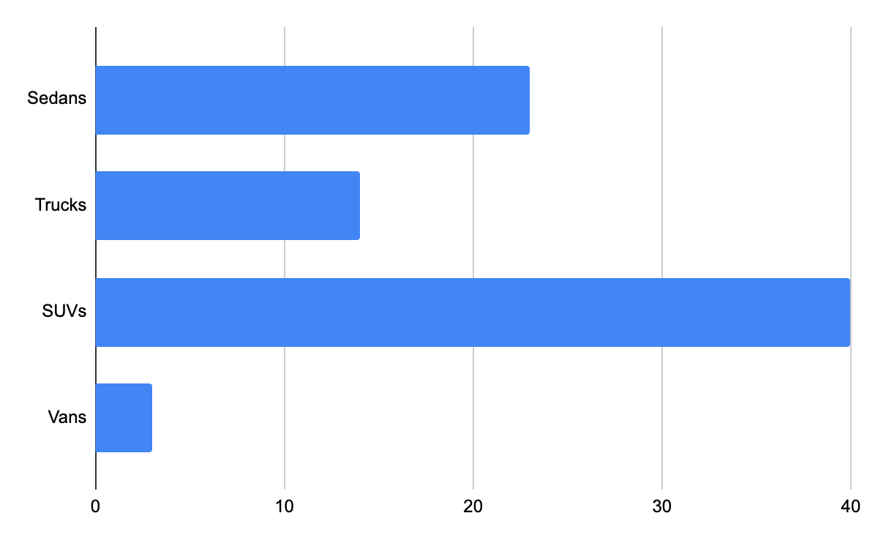
Visualizing Categorical Data: Bar Charts
Sedans | 23
Trucks | 14
SUVs | 40
Vans | 3

Slide 8
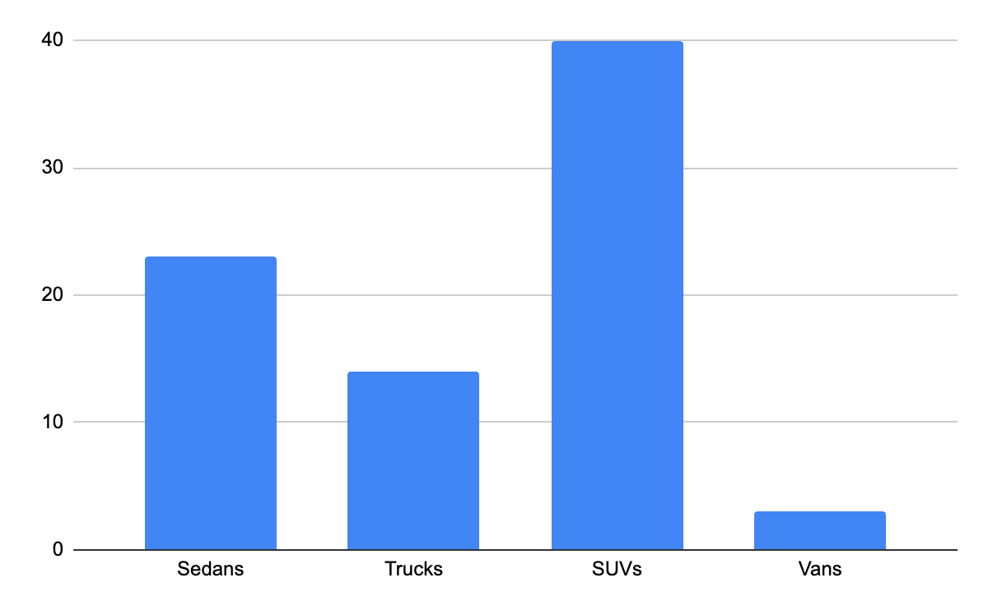
Visualizing Categorical Data: Column Charts
Sedans | 23
Trucks | 14
SUVs | 40
Vans | 3

Slide 9
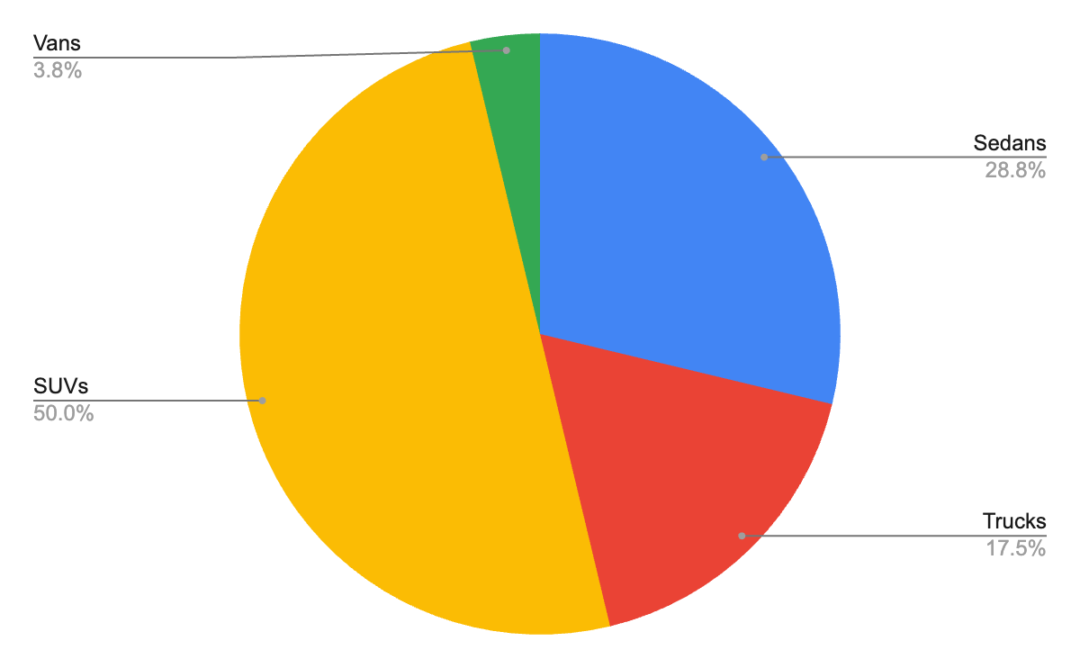
Visualizing Categorical Data: Pie Charts
Sedans | 23
Trucks | 14
SUVs | 40
Vans | 3

Slide 10
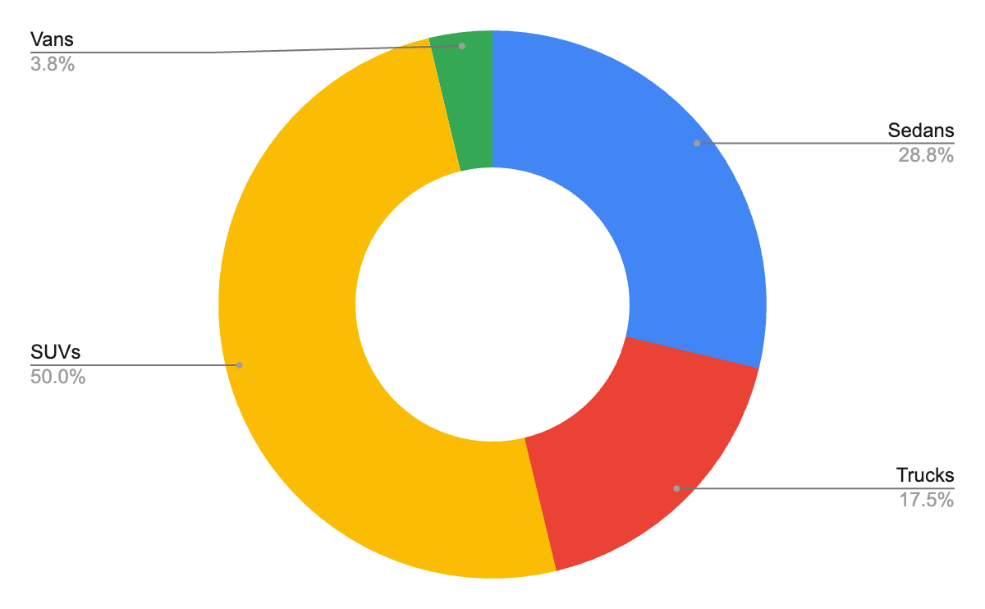
Visualizing Categorical Data: Donut Charts
Sedans | 23
Trucks | 14
SUVs | 40
Vans | 3

Slide 11
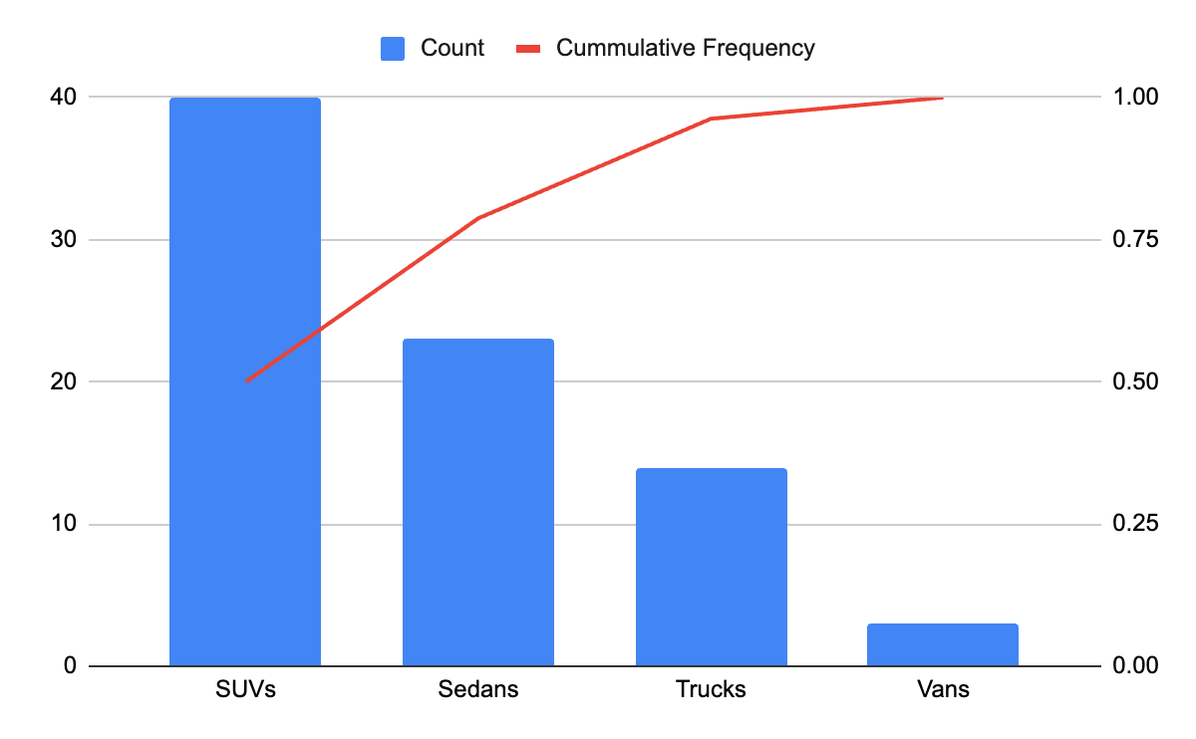
Visualizing Categorical Data: Pareto Charts
Sedans | 23
Trucks | 14
SUVs | 40
Vans | 3

Slide 12
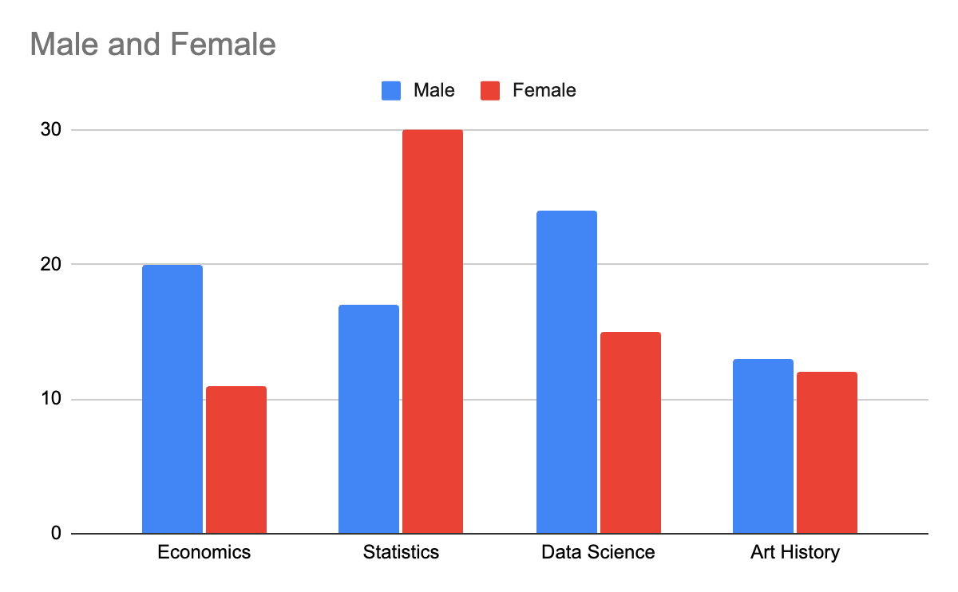
Visualizing Two Categorical Variables: Column Charts
 | Male | Female
Economics | 20 | 11
Statistics | 17 | 30
Data Science | 24 | 15
Art History | 13 | 12

Slide 13
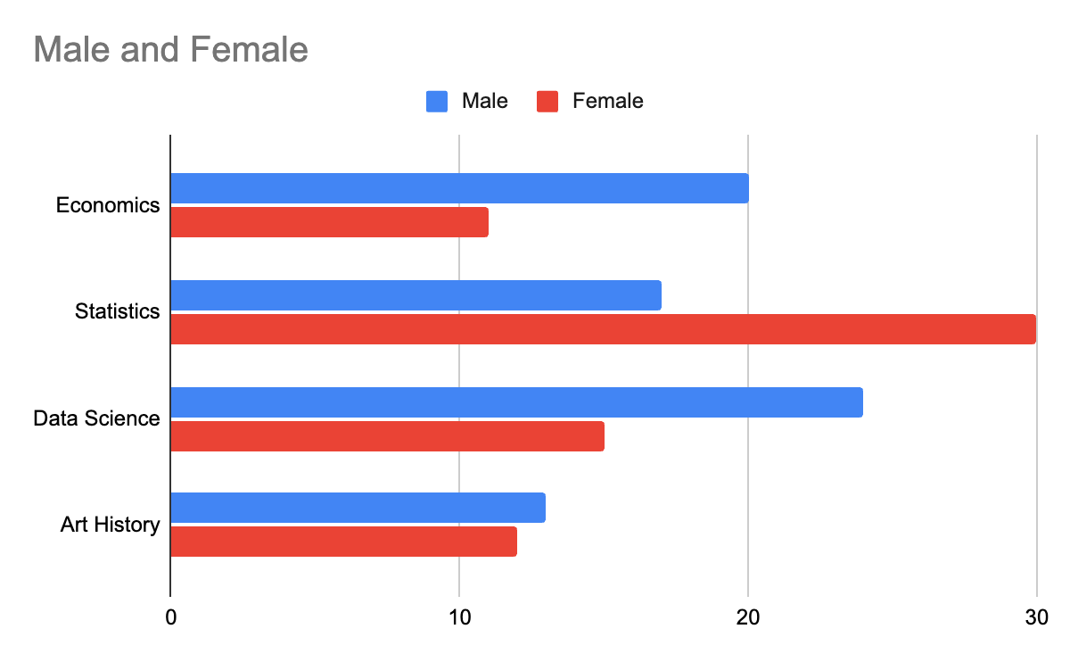
Visualizing Two Categorical Variables: Bar Charts
 | Male | Female
Economics | 20 | 11
Statistics | 17 | 30
Data Science | 24 | 15
Art History | 13 | 12

Slide 14
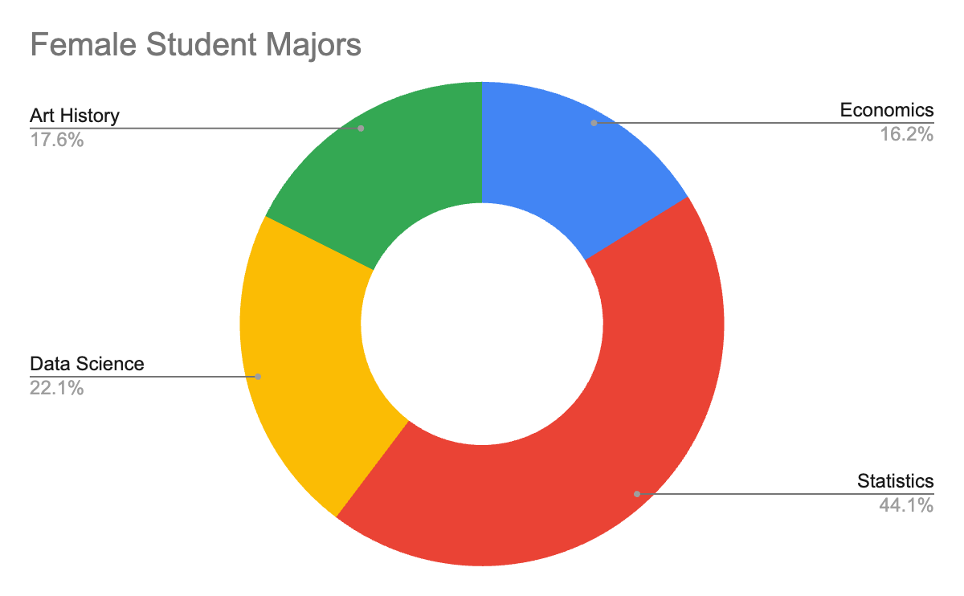
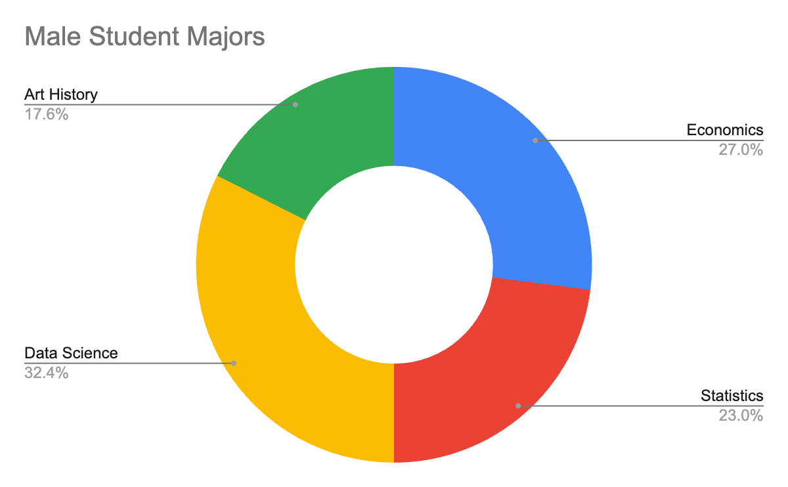
Visualizing Two Categorical Variables: Multiple Donut Charts
 | Male | Female
Economics | 20 | 11
Statistics | 17 | 30
Data Science | 24 | 15
Art History | 13 | 12

Slide 15
Types of Data: Quantitative
Numerical
Can be analyzed mathematically
Discrete or Continuous
Discrete if only using integers (counting numbers) / cannot be subdivided
Example: Numbers rolled on dice, Number of students in a class, Number of home runs in a baseball game
Continuous if using numbers that can be meaningfully subdivided into smaller / finer levels
Example: Time taken during a project, speeds of cars, heights of individual people

Slide 16
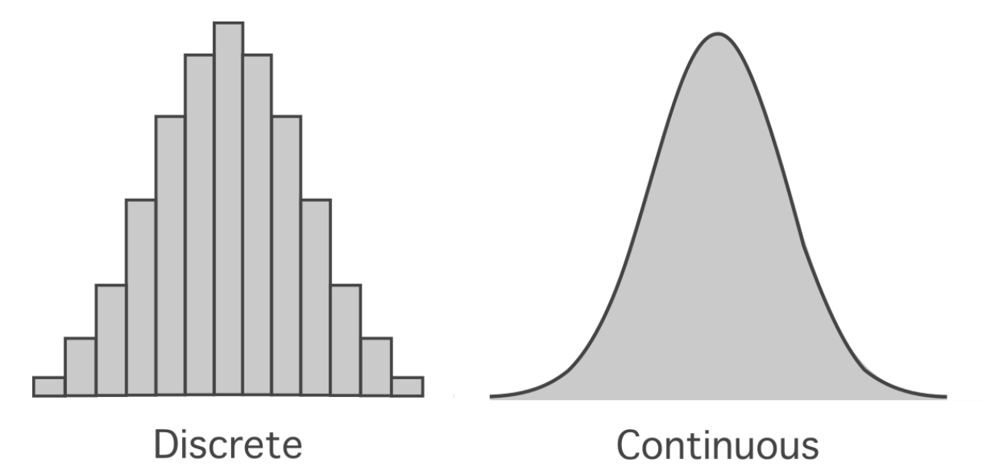
Discrete vs Continuous

Slide 17
Organizing Quantitative Data: Stem & Leaf Tables
Exam Grades:
68
65
79
87
92
89
67
81
90
Stem | Leaf
6 | 5 7 8
7 | 9
8 | 1 7
9 | 0

Slide 18
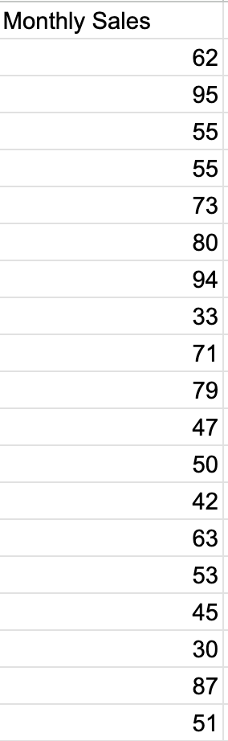
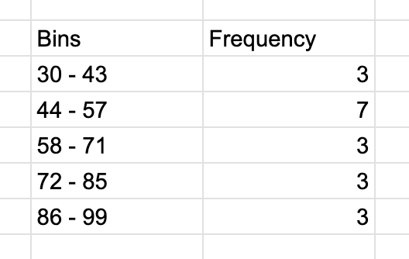
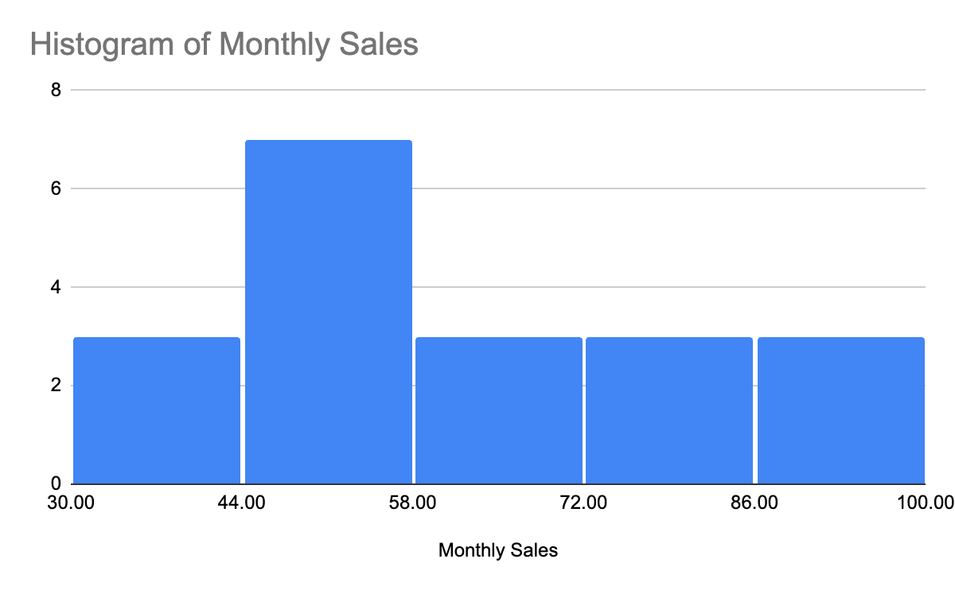
Visualizing Quantitative Data: Histograms
Similar to bar charts
Divide data into “bins” (typically between 5 and 20)
Height based on frequency / percentage of total count
Divide range of data (Max - Min) by bin count to get bin size / width
Example: If max = 95 and min = 30, range = 65. If five bins, bin width = 65/5 = 13
No gaps in bars if data are continuous

Slide 19
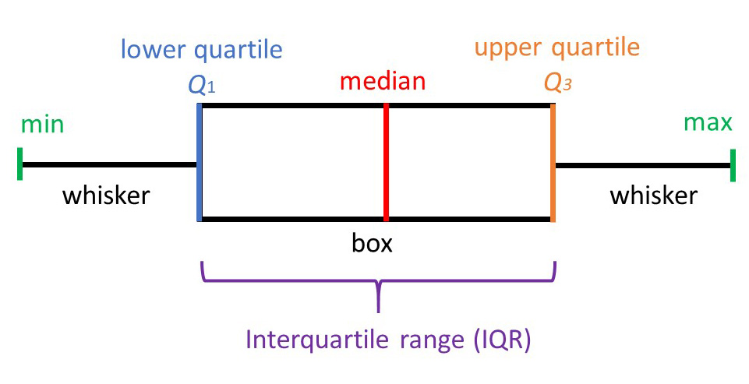
Visualizing Quantitative Data: Box and Whisker Plots

Slide 20
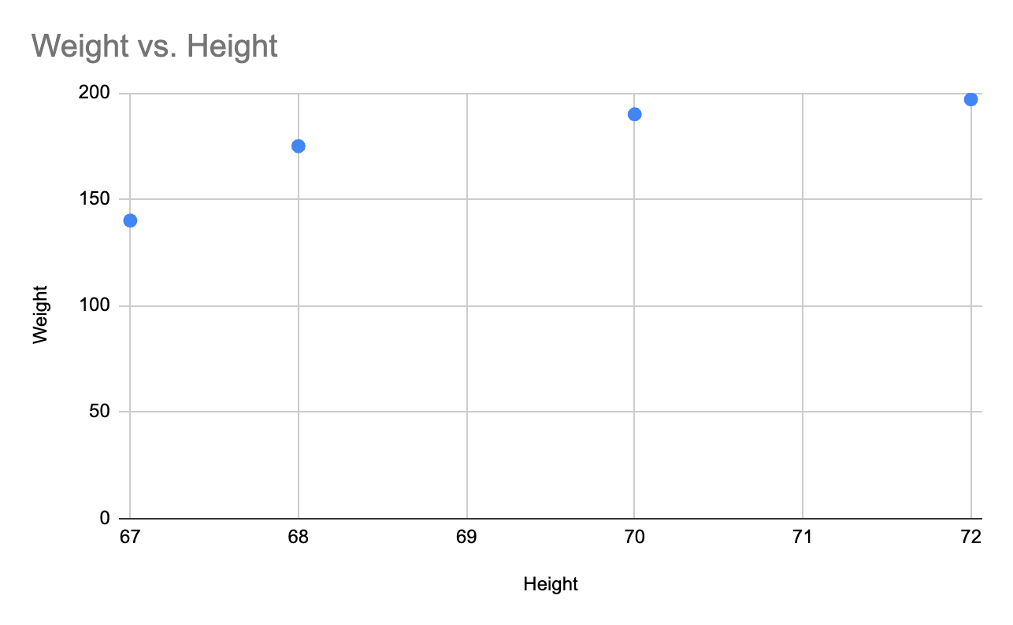
Visualizing Two Numerical Variables: Scatter Plots
Plot coordinate pairs of two variables
Height | Weight
67 | 140
68 | 175
70 | 190
72 | 197

Slide 21
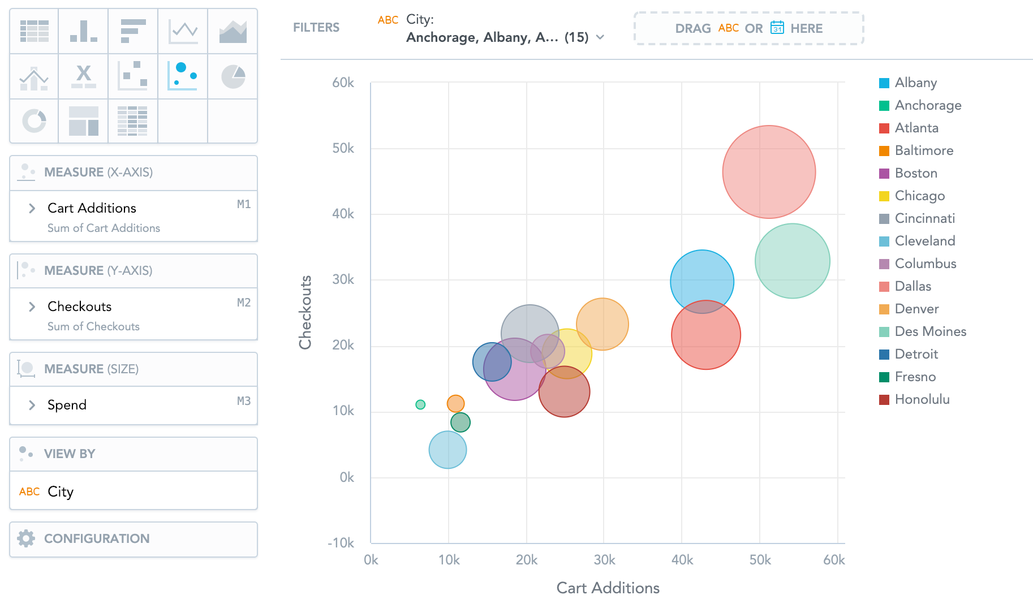
Visualizing Three Or More Variables: Bubble Charts
X and Y values go on the X and Y axes, respectively
A third variable, Z, is related to the size of the bubble
Color of bubbles could indicate another categorical or continuous variable
Remember: Just because you can, doesn’t mean you should…

Slide 22
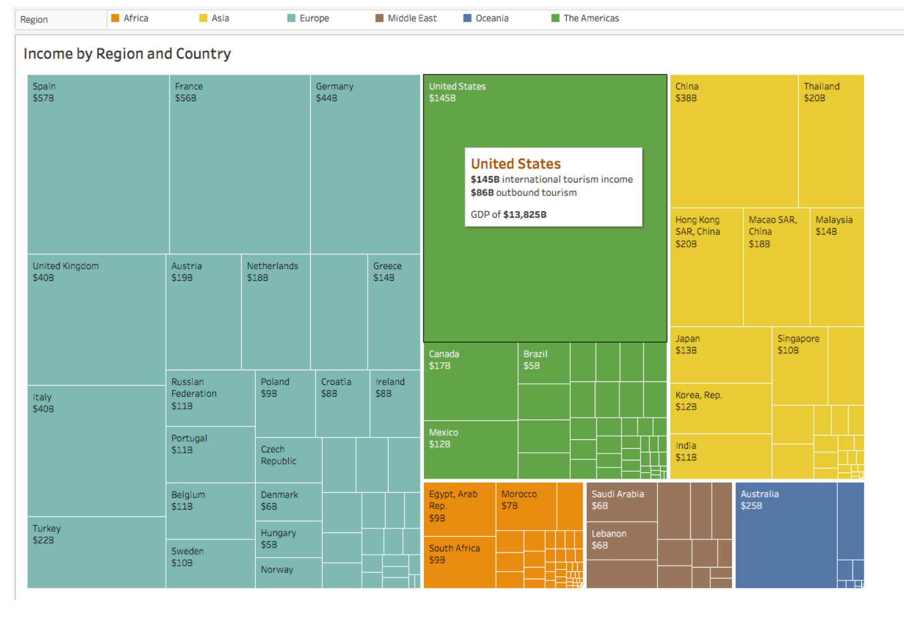
Tree Map
Area of squares shows relative magnitude of each category

Slide 23
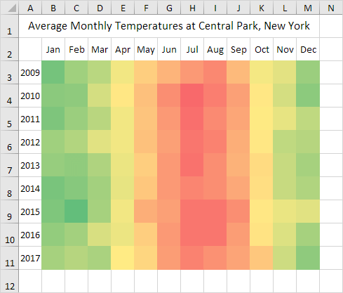
Heat Maps
Color of segment indicates direction and/or magnitude
Can be configured all sorts of ways

Slide 24
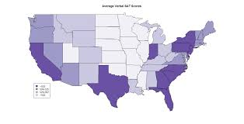
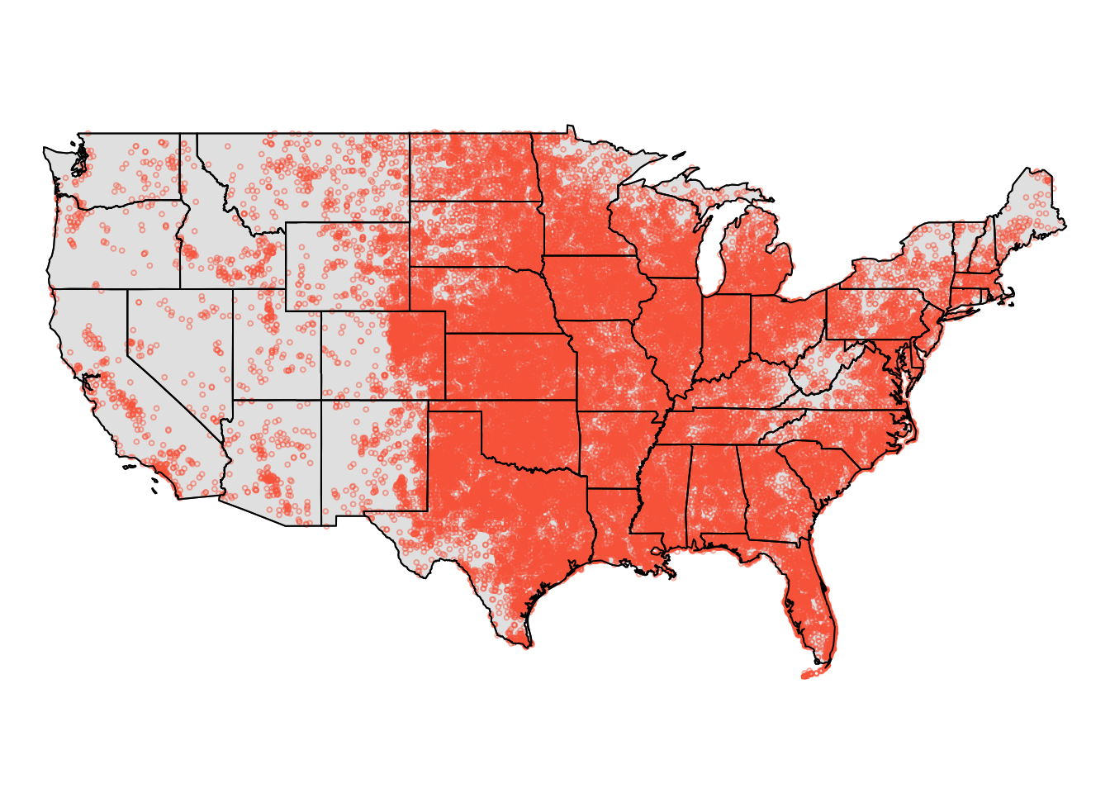
Spatial Data
Spatial data: Data with a location component
Data added to map as labels, points, colors, etc.
Sometimes called “geospatial” or GIS

Slide 25
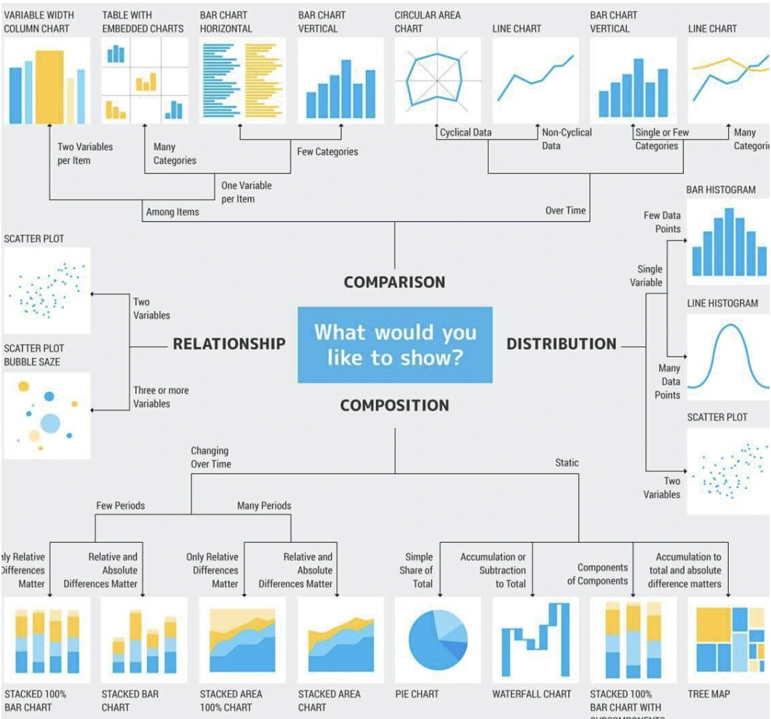

Slide 26
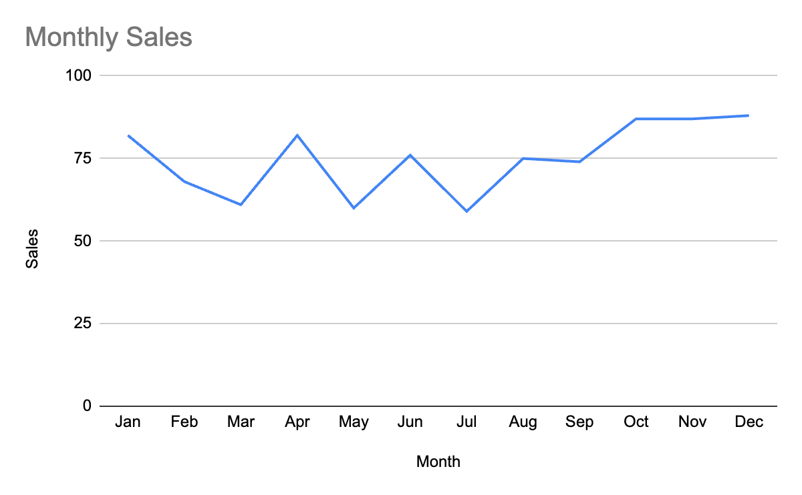
Visualizing Quantitative Data - Time Series / Line Charts
Month | Sales
Jan | 82
Feb | 68
Mar | 61
Apr | 82
May | 60
Jun | 76
Jul | 59
Aug | 75
Sep | 74
Oct | 87
Nov | 87
Dec | 88

Slide 27
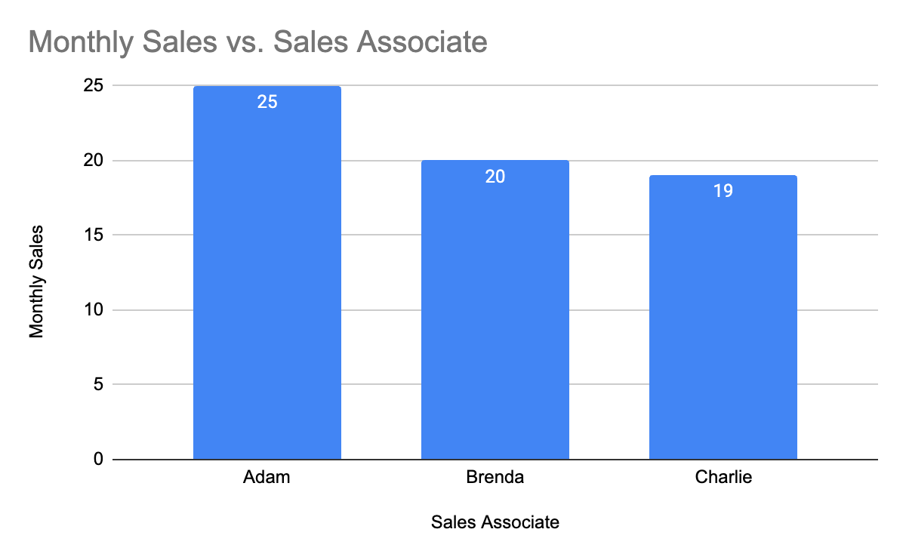
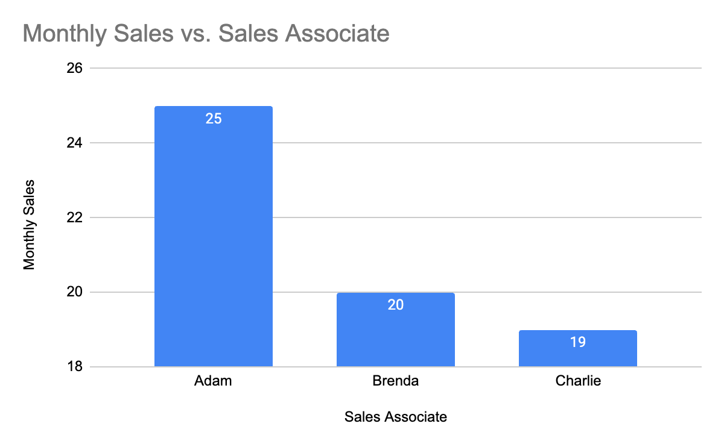
How To Lie With Statistics!
Mess with the axes!

Slide 28
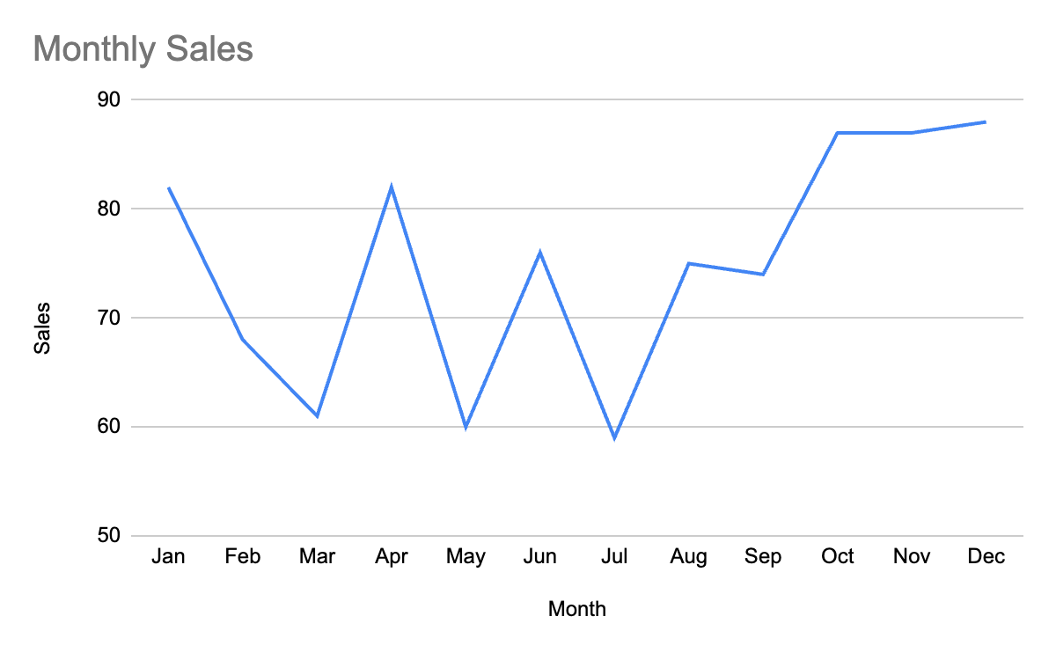
How To Lie With Statistics!
Mess with the axes!

Slide 29
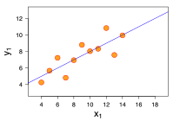
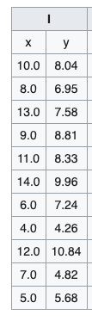
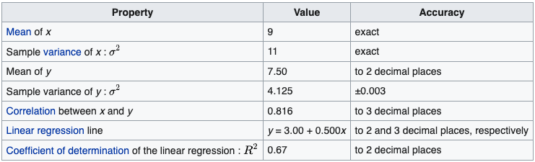
Anscombe's Quartet

Slide 30
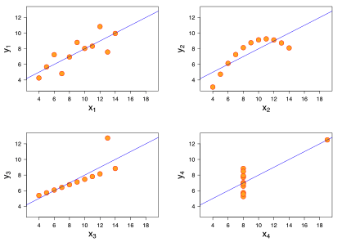

Slide 31
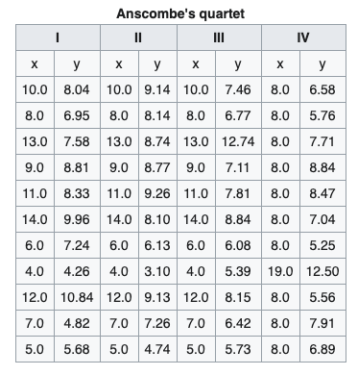
Anscombe's Quartet

Slide 32
Key lesson of Anscombe's Quartet: Visualizing data is a critical part of analysis, not just for fun, aesthetics, and/or showing others!!!

Slide 33
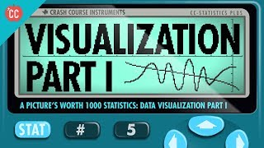

Slide 34
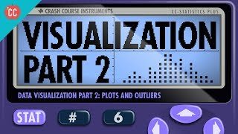

Slide 35
Sampling
Population: All of the items of interest
Example: All of the students at Webster University
Sample: A subset of the population
Example: Just the students in this room (assuming we’re interested in all of the students at Webster)

Slide 36
Why Sample?
We collect samples instead of measuring populations because:
It’s easier
It’s faster
It’s cheaper

Slide 37
Types of Sample - Non Probability
Non Probability Sampling: Items are chosen without regard to their probability of occurrence
Convenience: Items are selected because they’re easy to sample
Judgment: Items are sampled based on expert / domain knowledge
These are not good ways to sample!

Slide 38
Types of Sample - Probability
Probability Sampling: Sampling based on known probabilities
Simple Probability: Each element has an equal chance of being selected (w/ or w/o replacement)
Systematic: Select every n’th member of a population after a random start
Stratified: Divide the population into homogeneous subgroups called “strata”, then randomly sample from each stratum. Used to make sure samples are representative

Slide 39
So, what exactly is a statistic?
When a number is used to summarize an aspect of a population, it is called a parameter.
When a number is used to summarize an aspect of a sample, it is called a statistic.

